Slide 1
Distributed File Systems

Slide 2
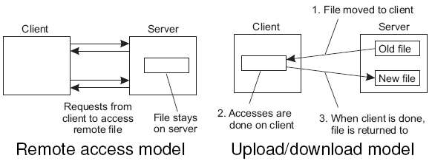
Distributed File Systems
General goal
Try to make a file system transparently available to remote clients.

Slide 3
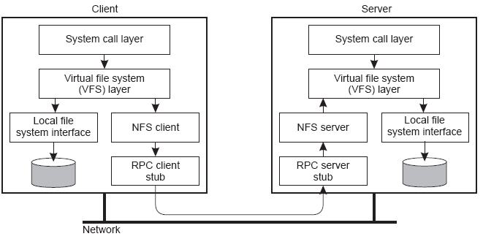
Example: NFS Architecture
NFS
NFS is implemented using the Virtual File System abstraction, which is now used for lots of different operating systems.

Slide 4
Example: NFS Architecture
Essence
VFS provides standard file system interface, and allows to hide difference between accessing local or remote file system.
Question
Is NFS actually a file system?

Slide 5
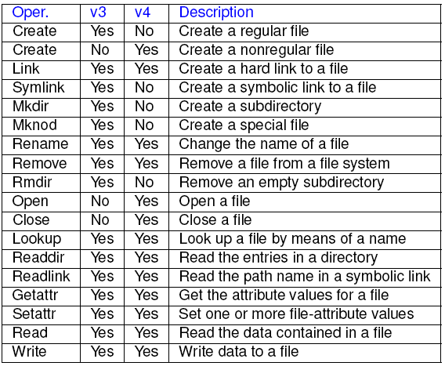

NFS File Operations

Slide 6
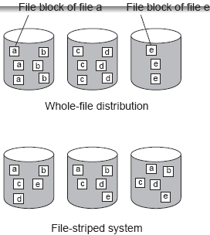
Cluster-Based File Systems
Observation
When dealing with very large data collections, following a simple client-server approach is not going to work for speeding up file accesses, apply striping techniques by which files can be fetched in parallel

Slide 7
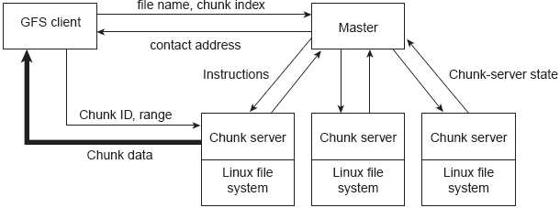
Example: Google File System
The Google solution
Divide files in large 64 MB chunks, and distribute/replicate chunks across many servers:
The master maintains only a (file name, chunk server) table in main memory minimal I/O
Files are replicated using a primary-backup scheme; the master is kept out of the loop

Slide 8
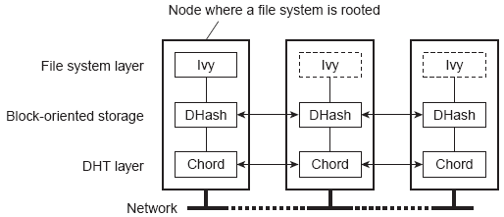
P2P-based File Systems
Basic idea
Store data blocks in the underlying P2P system:
Every data block with content D is stored on a node with hash h(D). Allows for integrity check.
Public-key blocks are signed with associated private key and looked up with public key.
A local log of file operations to keep track of <blockID;h(D)> pairs.

Slide 9
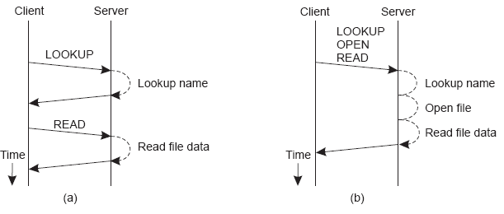
RPCs in File Systems
Observation
Many (traditional) distributed file systems deploy remote procedure calls to access files. When wide-area networks need to be crossed, alternatives need to be exploited.

Slide 10
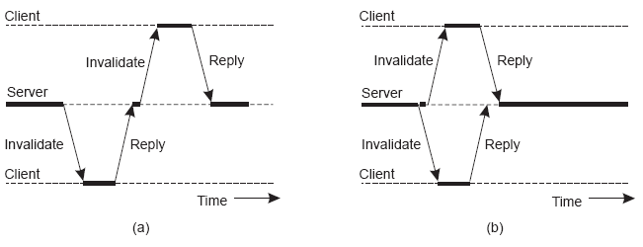
Example: RPCs in Coda
Observation
When dealing with replicated files, sequentially sending information is not the way to go.
Note
In Coda, clients can cache files, but will be informed when an update has been performed.

Slide 11
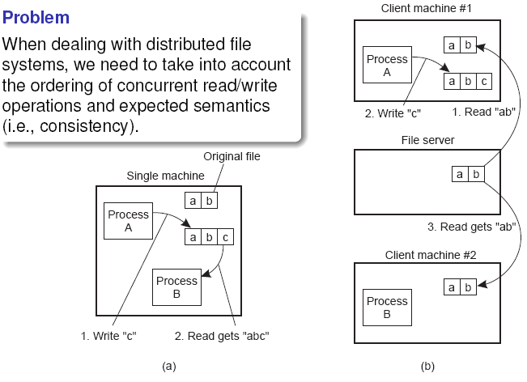
File sharing semantics

Slide 12
File sharing semantics
Semantics
UNIX semantics: a read operation returns the effect of the last write operation can only be implemented for remote access models in which there is only a single copy of the file
Transaction semantics: the file system supports transactions on a single file issue is how to allow concurrent access to a physically distributed file
Session semantics: the effects of read and write operations are seen only by the client that has opened (a local copy) of the file what happens when a file is closed (only one client may actually win)

Slide 13
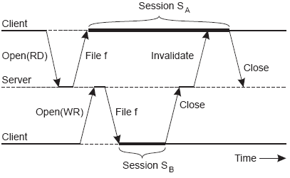
Example: File sharing in Coda
Essence
Coda assumes transactional semantics, but without the full-fledged capabilities of real transactions. Note: Transactional issues reappear in the form of “this ordering could have taken place.”

Slide 14
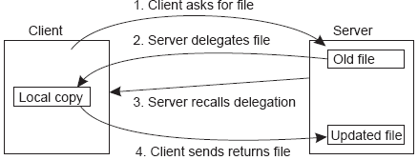
Consistency and replication
Observation
In modern distributed file systems, client-side caching is the preferred technique for attaining performance; server-side replication is done for fault tolerance.
Observation
Clients are allowed to keep (large parts of) a file, and will be notified when control is withdrawn servers are now generally stateful

Slide 15
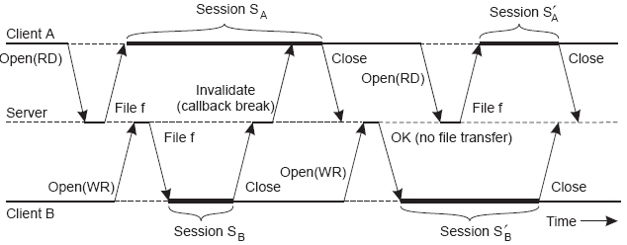
Example: Client-side caching in Coda
Note
By making use of transactional semantics, it becomes possible to further improve performance.

Slide 16
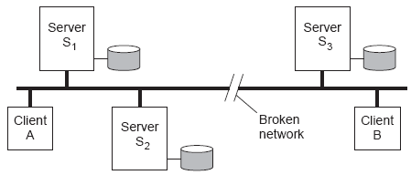
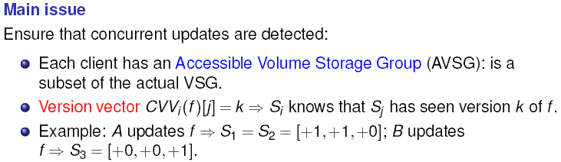
Example: Server-side replication in Coda

Slide 17
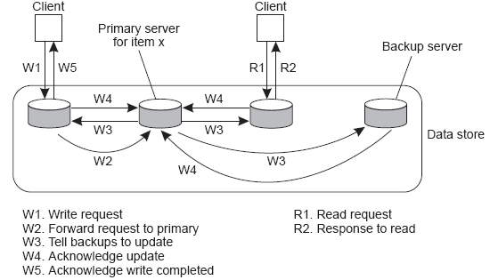
Fault tolerance
Observation
FT is handled by simply replicating file servers, generally using a standard primary-backup protocol:

Slide 18
High availability in P2P systems
Problem
There are many fully decentralized file-sharing systems, but because churn is high (i.e., nodes come and go all the time), we may face an availability problem replicate files all over the place (replication factor: r_{rep}).
Alternative
Apply erasure coding:
Partition a file F into m fragments, and recode into a collection F* of n > m fragments
Property: any m fragments from F* are sufficient to reconstruct F.
Replication factor: r_{ec} = n/m

Slide 19
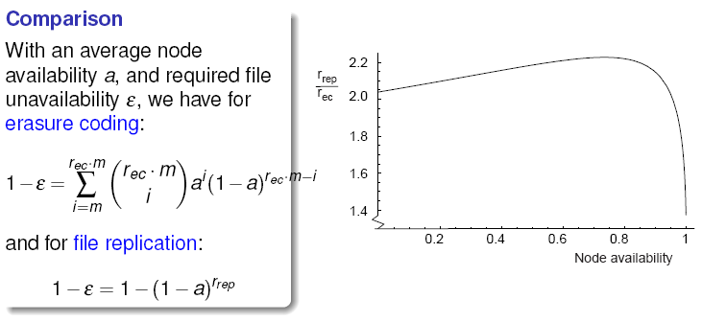
Replication vs. erasure coding

